Slide 1


Steel Industry Energy Consumption
In a smart small-scale steel industry in South Korea
Vithushan Vadivel
SEP 23rd | PARIS
DAFT JUL25

Slide 2


Business case
Steel industry is consuming more energy than other manufacturing industries. It is not possible to reduce the constructions and can not use any metal instead of steel.
So the business case is to findout the timeslot where the more energy consumption is high and can suggest the other industries to manufacture process in time slot where the minimum load of energy is used:
Energy Consumptions is high in industries, if there is possibilities to reduce the energy consumptions or to use the energy in efficient way?

Slide 3
Plan
Investigation of my business case
Look for data related to my business case
Data collection
Data cleaning and exploratory data analysis
Decide on database type
Build my ERD Model
Creation of database and data importation
Write queries for insights
Modeling (supervised ML, time series)
Conclusions

Slide 4
About data
Daily recorded usage , Lagging Current reactive power, tCO2(CO2, Load Type, Week Status, Day of week are available every 15 minutes from the beginning of day of January 1st to 31st December 2018.
displays daily usage , current reactive power, co2 emission data every 15 minutes in the year 2018
Presents comparable data set from January 1st to 31st December 2018 and time slot
(pccs.kepco.go.kr)

Slide 5
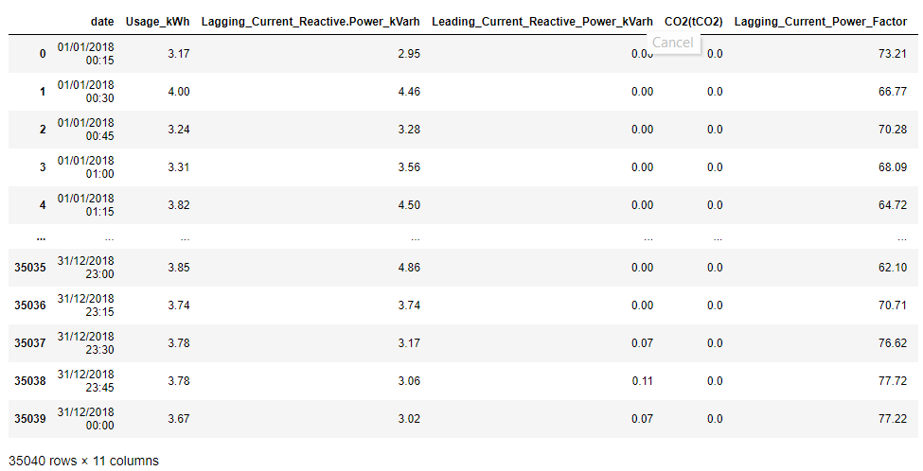
Data collection
Data collection is the essential part of this project. I have collected the Data from the websites of UCI which is the Repository of datasets for machine learning and intelligent systems
I have selected this data to do the project in the supervised machine learning as it has 11 features to determine the Load Type of electrical energy consumptions.

Slide 6
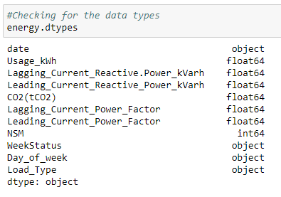
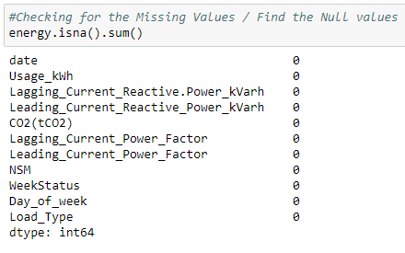
Data cleaning and EDA
Importing necessary libraries
Importing Data by reading csv file by pandas
Initialization of Data Cleaning Process
Checking .info(), .shape() to get more details of the data.
Checking column names to verify whether there is a unwanted space or not and changed to the common name structure.
Checking data types(.dtypes) whether they are in the correct data variables
2. Checking and dealing with missing values
3. Getting exploratory analysis and dealing with outliers by using .describe() function

Slide 7
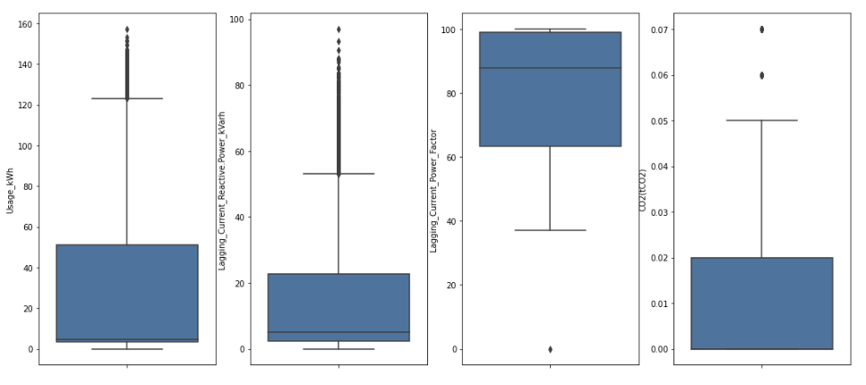
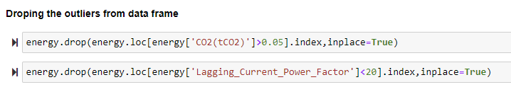
Data cleaning
Checking Ouliers using boxplots for each numerical columns and removing the outliers using drop functions

Slide 8
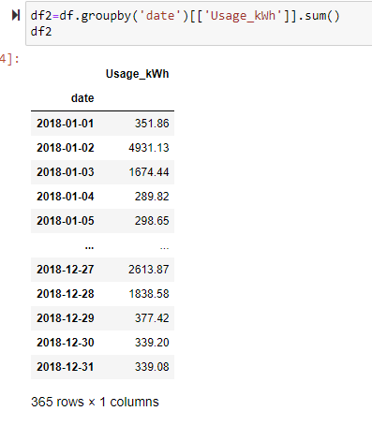
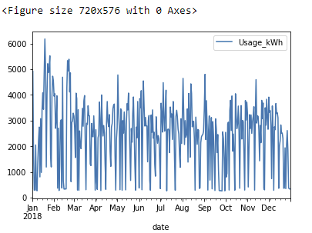
Exploratory Data analysis

Slide 9
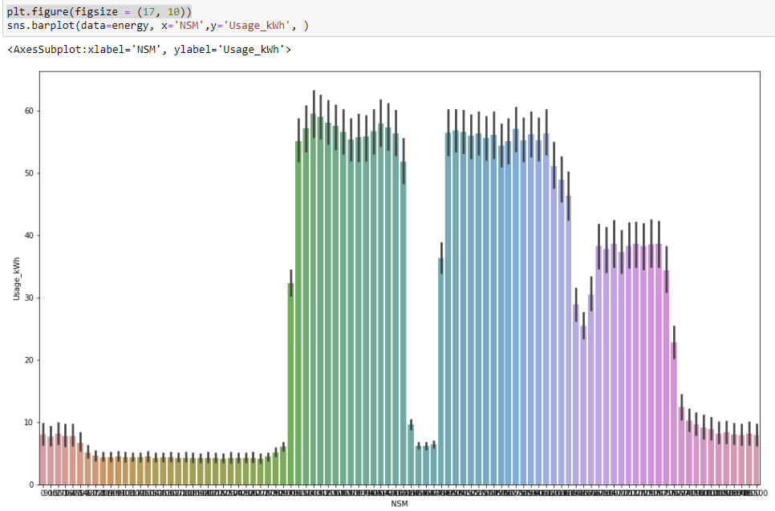
Exploratory Data analysis
Barplot to show the usage of power changes by every 15 minutes in the whole year 2018

Slide 10
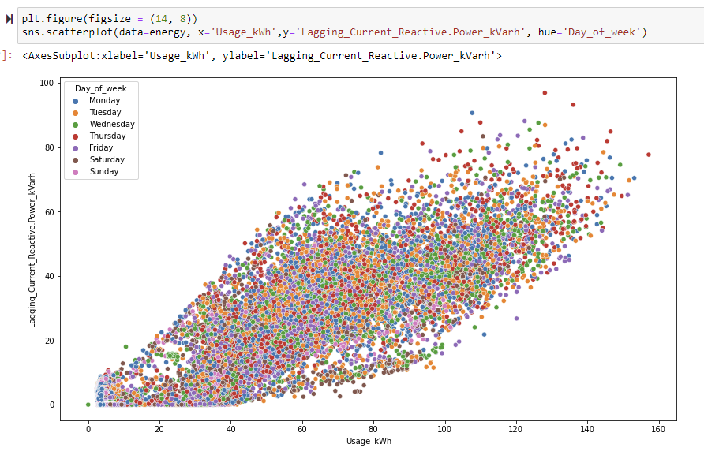
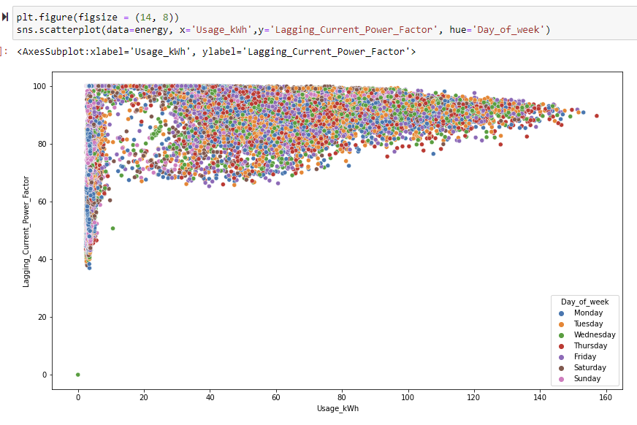
Exploratory Data analysis
Scatterplot to show the correlations in between Usage of energy and Lagging current reactive power and Lagging current power factor

Slide 11

Data base comparison
I decided to use a SQL database
allows me to use my cleaned and converted data frames
perform queries on a small level.
link the different tables with each on their relational basis.
do not care about object-oriented programming
writing longer queries is acceptable
The most important factor is to be able to work with the output of my data cleaning process: structured data
The relational database I will use is MySQL
Notes:
Centralized: stores data at a centralized database system + access from different locations + authentication process Distributed: distributed among different database systems + database systems are connected via communication links Relational: based on the relational data model + which stores data in the form of a table (row +column) + uses SQL for storing, manipulating Object-oriented: uses the object-based data model approach for storing data Why SQL: ability to store the data collected + ability to create queries and retrieve information + ability to create relations or not

Slide 12
Deciding on what type of database to use
SQL | NoSQL
can work with smaller amounts of data | can work with big amount of data
supports transactions on cell level | does not support atomic transactions
slower querying, but faster updating | slower update, faster querying
Structured data | unstructured or semi structured data
OOP unfriendly (object oriented programming) | OOP friendly
Following my plan, the next step is creating my database. I decided to use SQL because this type of database allows me to use my cleaned and converted data frames (structured data) and perform queries on a small level. Furthermore, I can link the different tables with each other using primary and foreign keys which allows me to quickly make queries and join different information from various tables. In my situation I also do not care about how friendly the system is towards object-oriented programming and writing longer queries is acceptable. The most important factor is to be able to work with the output of my data cleaning process: structured data. The relational database I will use is MySQL. In order to prepare the foundation for the creation of my database I created the following entity relationship model to clarify the different entity tables I will use and specify their relationships.

Slide 13
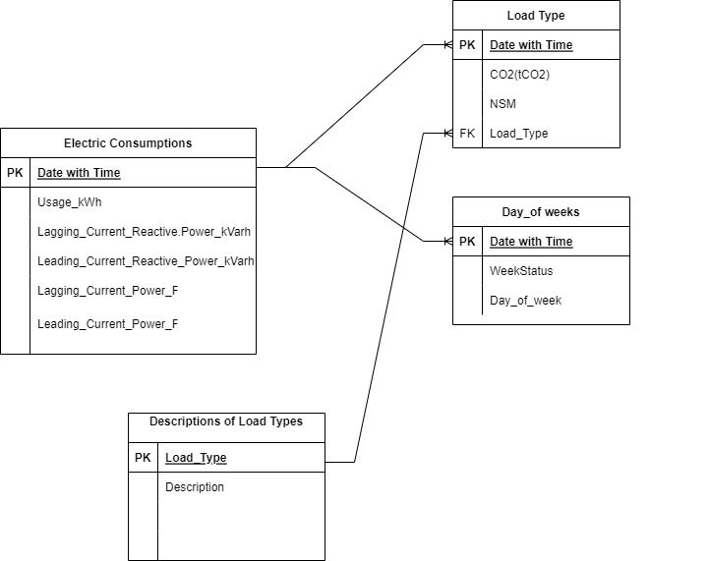
ERD
Electric consumption entity: Date with Time is the primary key and it has the other factors which influence in the consumptions of electrical energy
Load Type entity : Here also Date with Time is the primary key and it has the features of emission of CO2 number of seconds from midnight, load types
Day of week entity: here also Date with Time is the primary key and it has week status and day of week
Descriptions of load type entity: Load Type is the primary
key and it has just descriptions

Slide 14
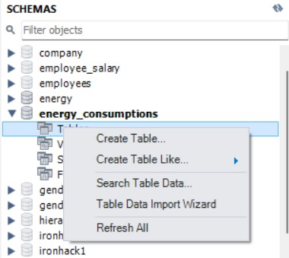
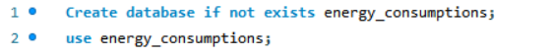
Database creation
As because the data is huge, all entity is imported through table data import wizard.

Slide 15
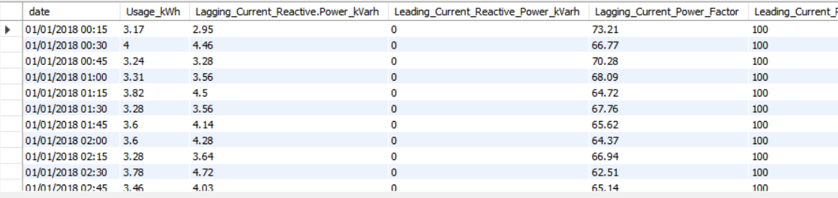
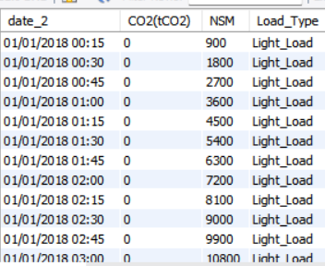
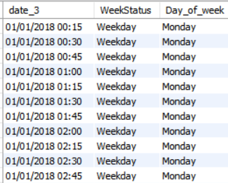
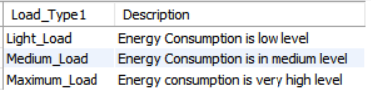
Tables

Slide 16
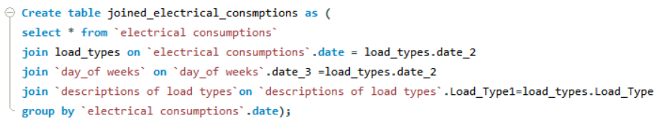
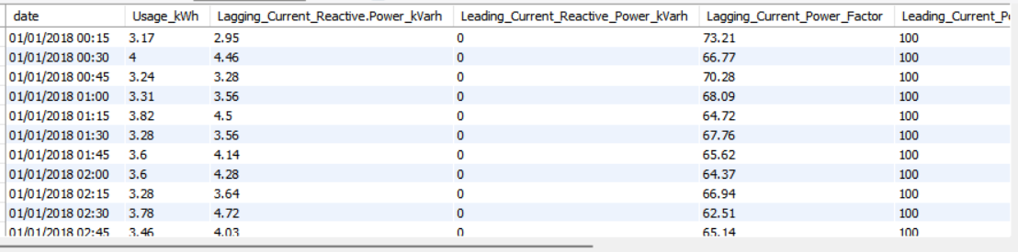
Joining Entities into one table using Primary keys and Foreign keys

Slide 17
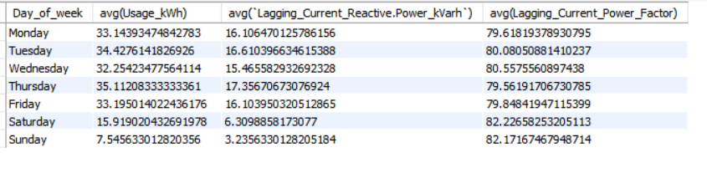
Insight queries
checking the average use of electricity in week days is approximately same and less amount of energy is used in weekends.

Slide 18
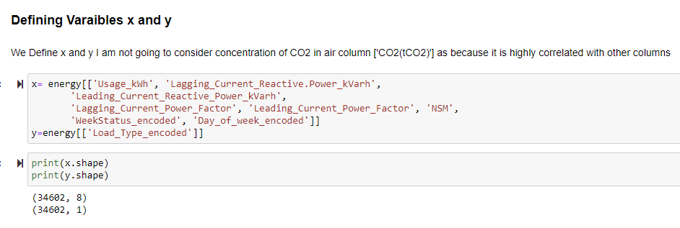
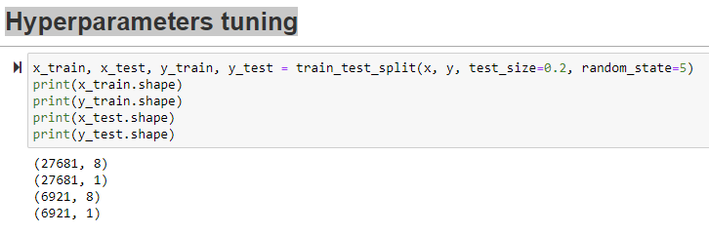
Supervised Learning: load type prediction
Hyperparameters tuning

Slide 19
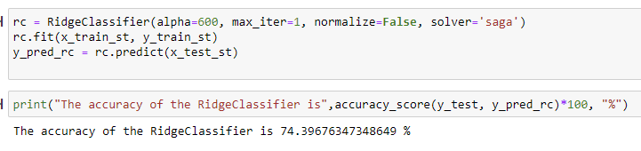
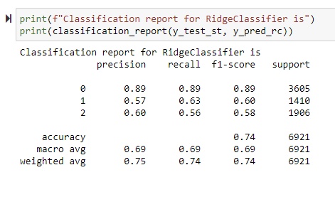
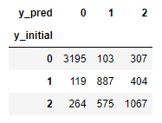
RidgeClassifier – Model Testing
Notes:
Solar hydro and

Slide 20
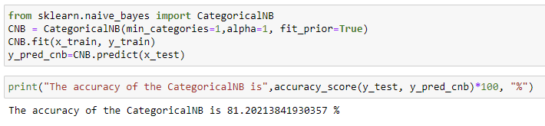
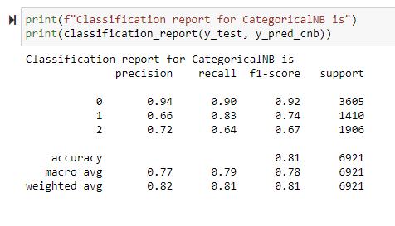
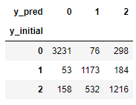
CategoricalNB - Model Testing

Slide 21
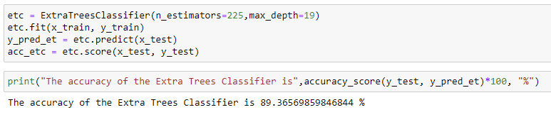
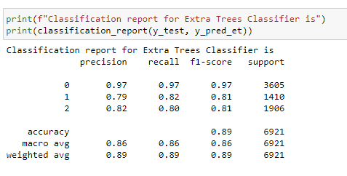
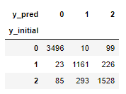
Extra Trees Classifier - Model Testing

Slide 22
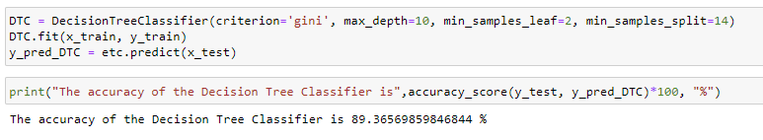
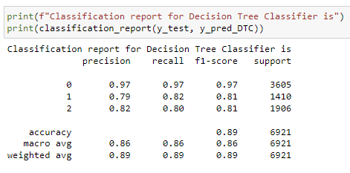
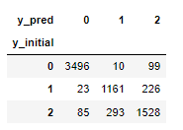
DecisionTreeClassifier - Model Testing

Slide 23
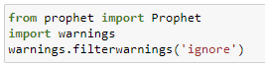
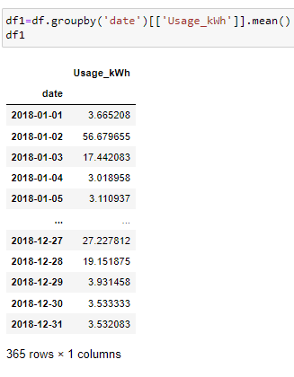
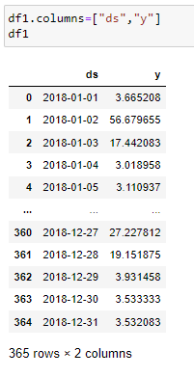
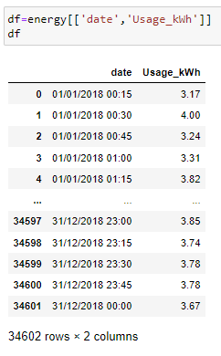
Forecasting Timeseries using Prophet
Forecasted consumption of energy for the year 2019 by using prophet library in python

Slide 24
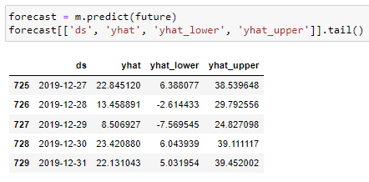
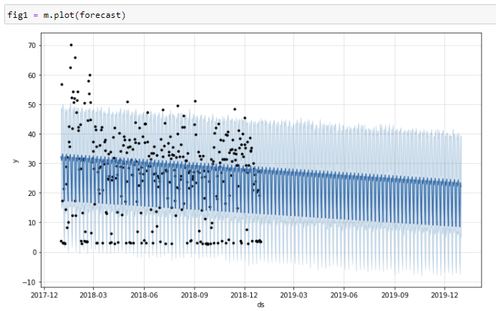
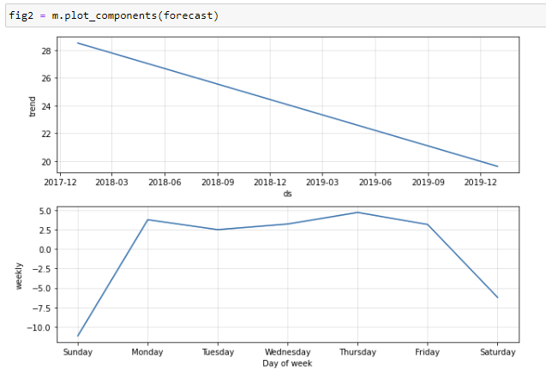
Forecasting Timeseries using Prophet

Slide 25
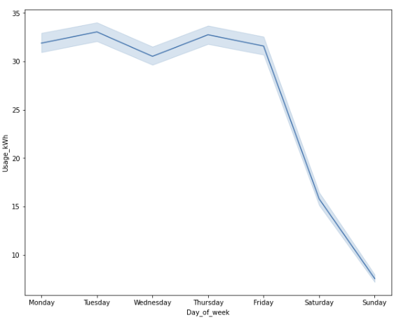
Conclusions
We can easily predict the type of load by using DesicionTreeClassifier (accurasy is 89%)
The time series forecast allows to see that the concumption of energy will decrease
The descriptive analytics brings the insight that it could be useful to launch plants during the weekends
Notes:
For example the fact that over 150 cities recorded in the data were based in the US might have affected the output of my analysis regarding the general temperature increase over the years. If I would have had more time, further steps could have been taking into account more data measurements about different countries so there would be an equal amount of data for each country proportionally.

Slide 26
Questions?

